Slide 1
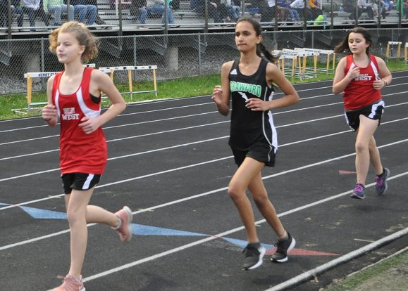
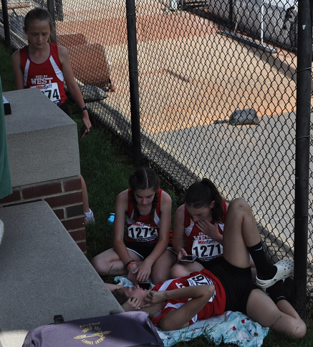
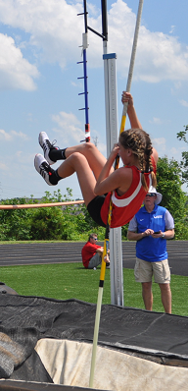
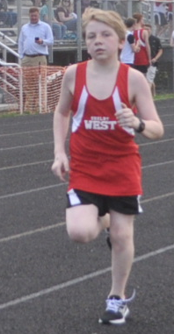
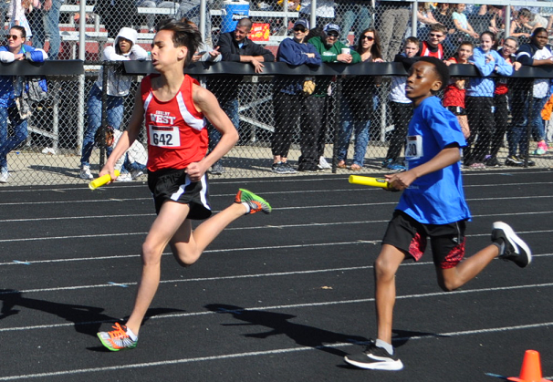
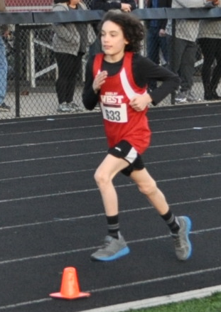
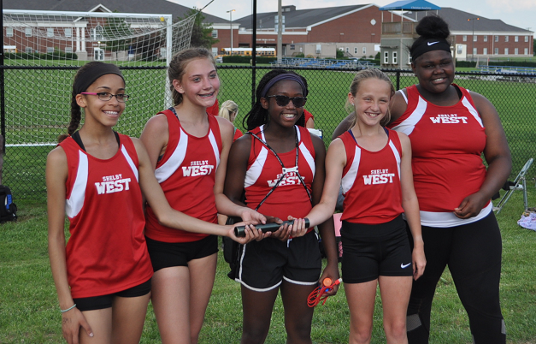
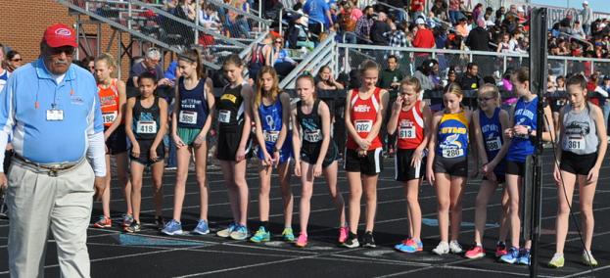

SHELBY WEST 2019 TRACK & FIELD
SEASON REVIEW MEETING

Slide 2
COLLINS / WEST TRACK & FIELD
SEASON REVIEW
AGENDA
Season highlights
What’s next
Awards & recognition
Thanks
What we need to work on
What are The Running Warriors all about?
Questions & comments

Slide 3
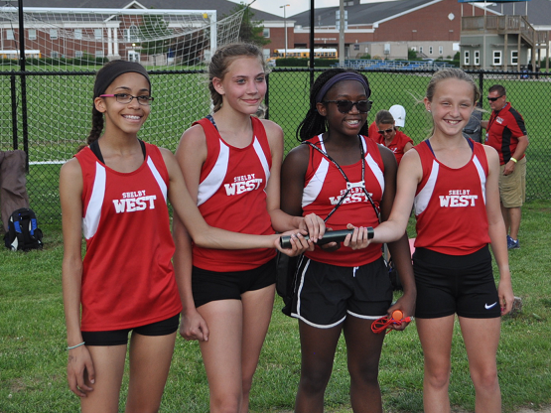
Season Highlights
    Seven girls’ school records
      400 Evalyn Hetrick – 1:08.93
      800 Emma Kendall – 2:38.16
      3200 Emma Kendall – 12:25.01
      4 X 400 Relay: E. Heterick, C. Turpen, T. Rawlins, and E. Kendall – 4:51.56
      SP Kierra Williams – 30-11.5
      DI Kierra Williams – 74-5
      PV Grace Evans 6-0

Slide 4
Season Highlights
    State Meet
      7 Girls made State
      6 Boys made State

Slide 5
What’s Next
Recovery – give our bodies chance to recover – rest period
Cross country summer workouts
Summer Meets – info on www.runningtitans.com
  Summer USATF JOs June 8th at Centre College (Danville)
    Age group 11-12,13-14, 15-16, 17-18 http://kentucky.usatf.org/Home.aspx
  Bluegrass State Games July at UK
  Vault in the Ville July 13-16 (4th Street Live)

Slide 6

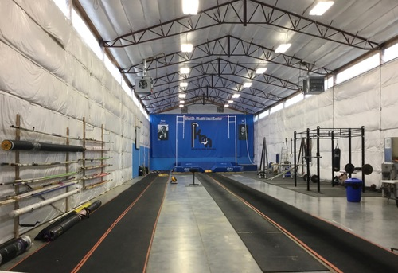
What’s Next
Summer Camps:

Slide 7

Awards & Recognition

Slide 8
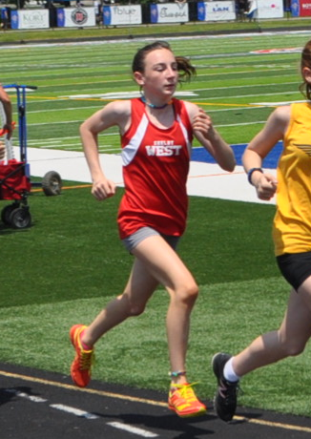
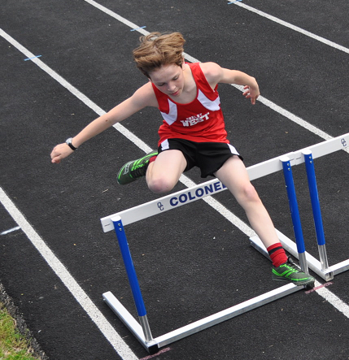
Awards & Recognition - West
Top Newcomer Award
Grace Evans
Nathan Janes

Slide 9
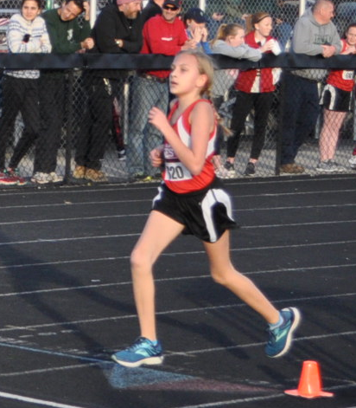
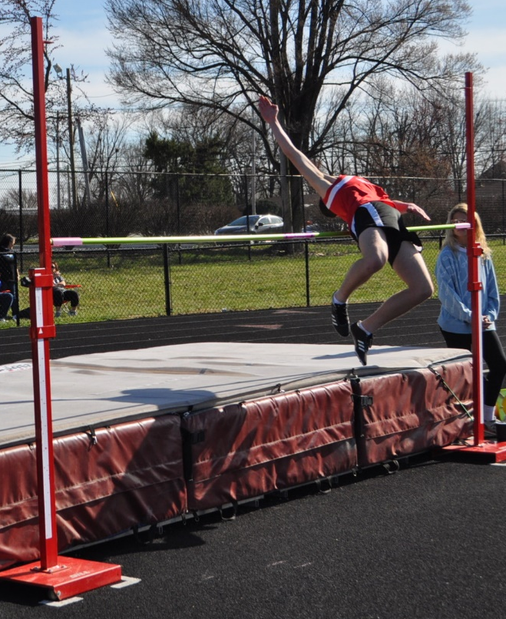
Awards & Recognition - West
Warrior Award
Katelynn Stevens
Jacob Rowe

Slide 10
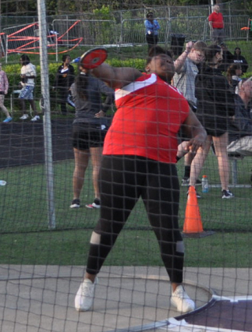
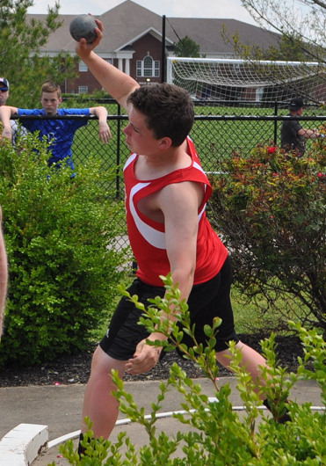
Awards & Recognition - West
Most Valuable Field Athlete
Kierra Williams
Zach Zimmerman

Slide 11
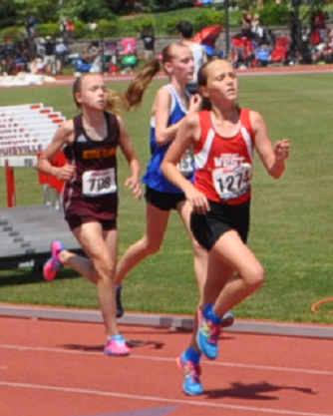
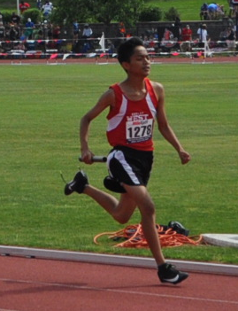
Awards & Recognition - West
Most Valuable Track Athlete
Emma Kendall
Melbyn Ixocy-Velasquz

Slide 12
THANKS
We Couldn’t Have Done it Without You!
The Season Truly Was a TEAM Effort!
Great evening tonight – thanks to everyone who brought things
Coaches
  Michelle Vest
  Robert Rowe
  Aja Leachman

Slide 13
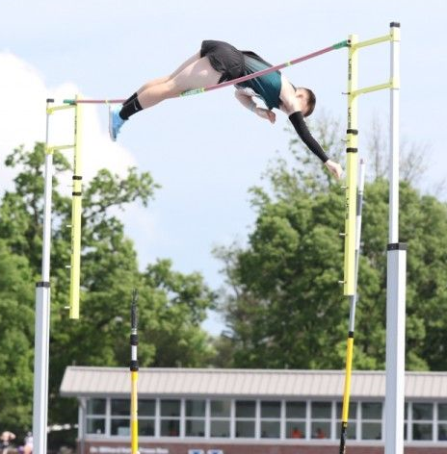
What We Need to Work On
Work to keep top athletes to compete in high school
Tap deeper into the Hispanic student athlete population
We need male pole vaulters
  With one of the best high school training facilities in the Southeast just down the street – it’s a shame we can not get more vaulters (KEA had 3 KY State Champs)
  Why the reluctance?
Clay Franklin, a freshman at North Oldham and KEA athlete, clearing 15-2 at the KY State Meet to break the State AA PV record.

Slide 14
What Are The Running Warriors About?
Branded theme for cross country and track and field teams
  The best in running, jumping, and throwing (…race walking too!)
We believe The Running Warriors are about creating strong VALUES like:
  Teamwork
  Discipline
  Dedication
  Selflessness
  Integrity
  Sportsmanship

Slide 15
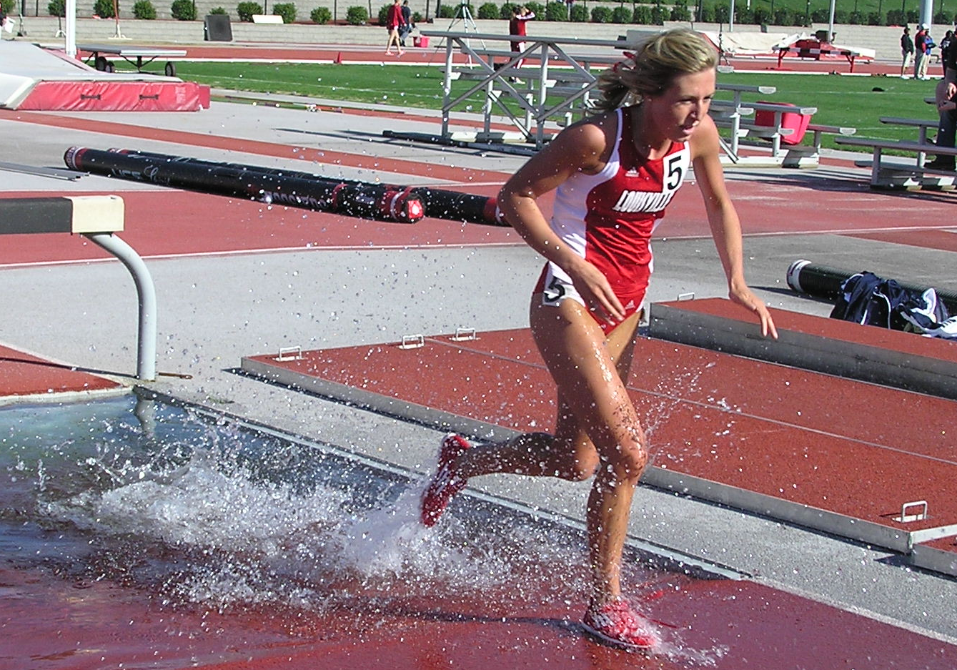
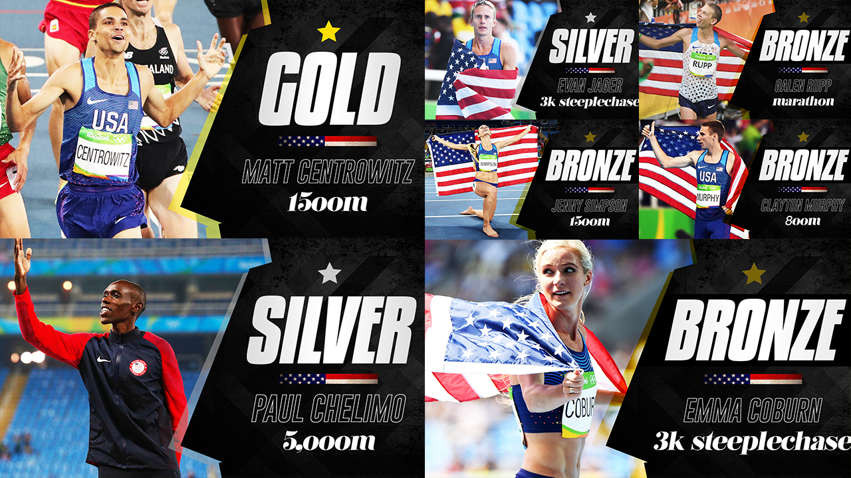
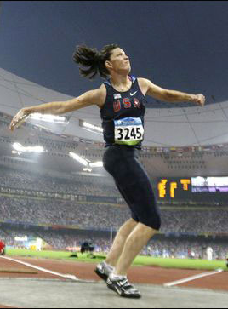
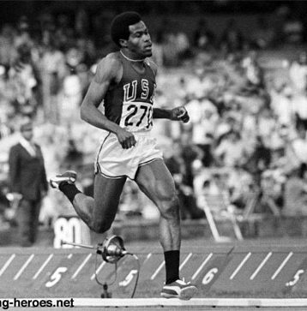
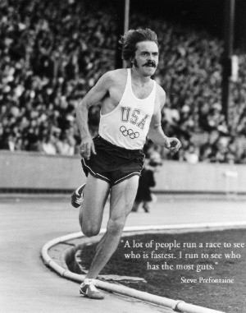
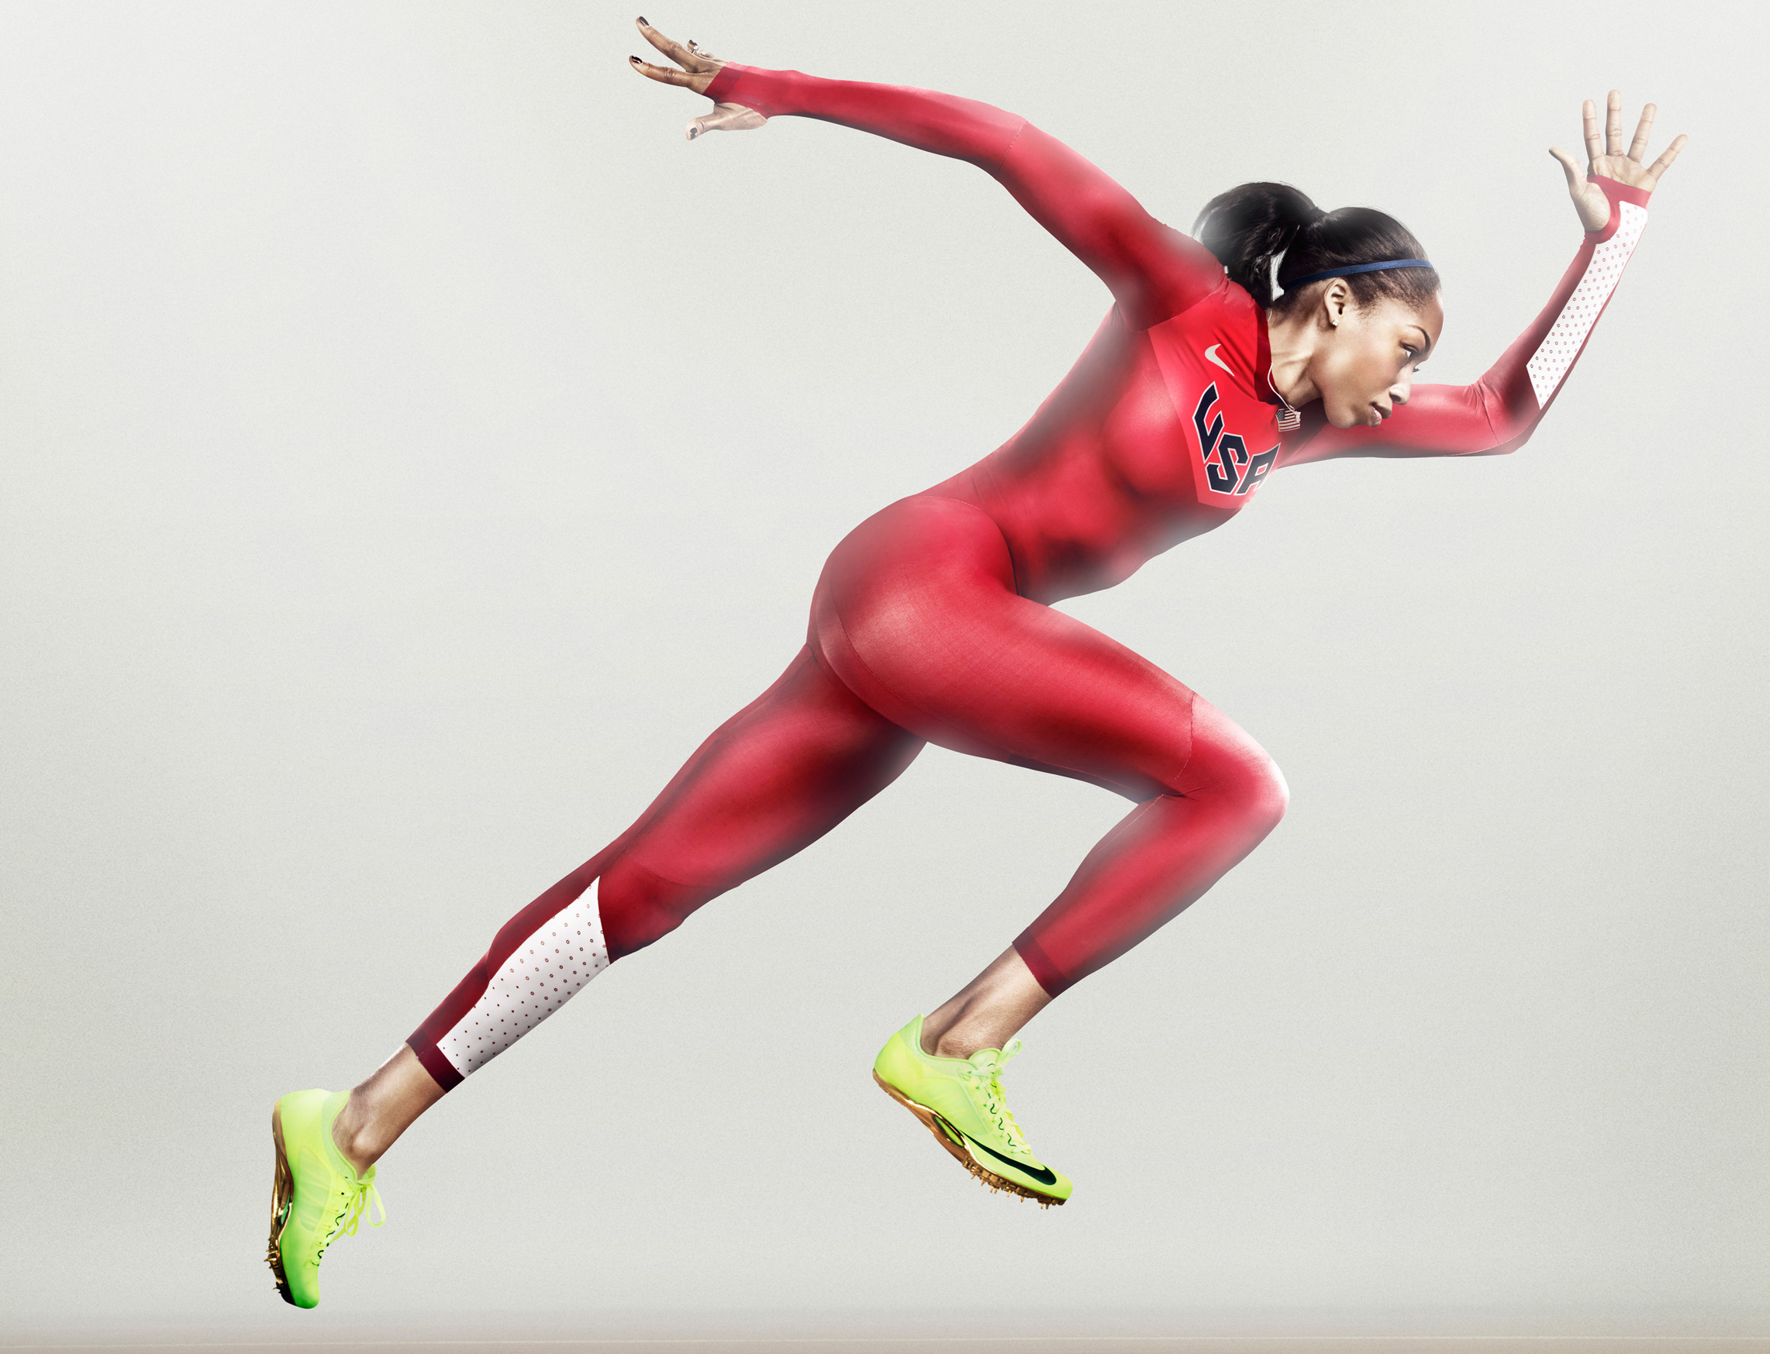
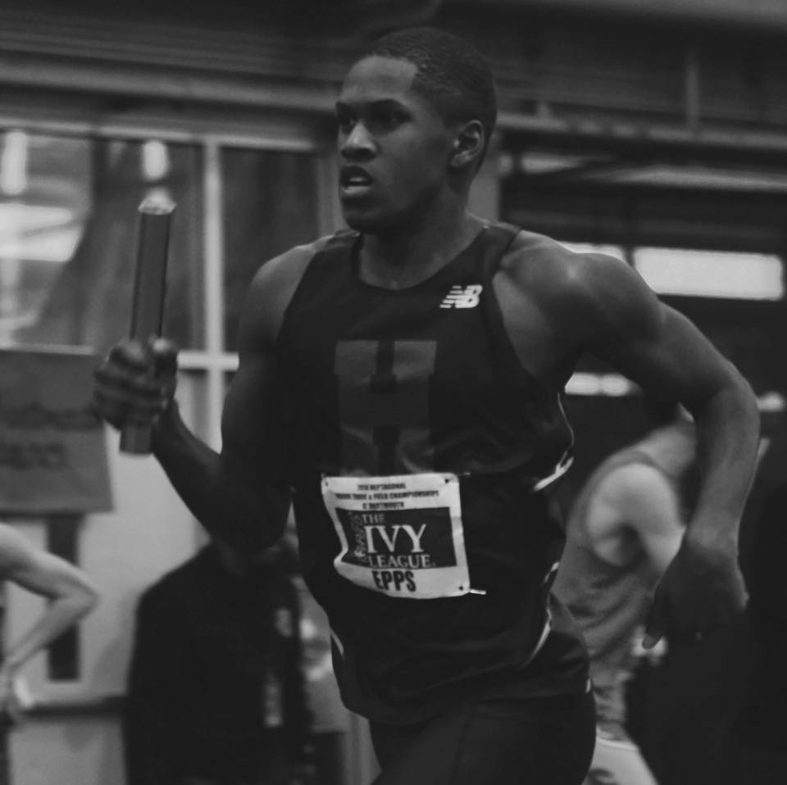
Questions & Comments
Check www.runningtitans.com frequently!!!
Check out SWMS Track & Field on MileSplit http://ky.milesplit.com

